Slide 1
Doing Good Research and Experiments!
Dual-Degree orientation for CVIT Group https://tinyurl.com/2023CVIT-DDWorkshop
May 27th, 2023

Slide 2
Slides by Vladlen Kotlun (Intel)
Doing (Good) Research
Welcome to the CV community! Good Citizen workshop @ CVPR 2018
What is Research?
Ways to contribute
Picking an area (work with your advisors on this)
Publications
On high standards
Work ethic
Ethics

Slide 3
Best Practices in ML
Link to the document
Research Attitude
This is not coursework
Creating new information is not easy
Celebrate the small wins
Adopt the scientific method
Never forget ML 101 (even when you are experienced)
When working with a new dataset
When working with a new model
Loss functions and plots
Closing the loop
[check out the doc]

Slide 4

Experiments

Slide 5
Wonderful Twitter threads by Jia-Bin Huang
Doing research with your advisor / mentor / collaborators
How to work with your advisor(s)?
How to meet with your advisors/mentors?
How to share your progress with your mentors/collaborators?
How to do research with my mentors effectively?
Writing well
How to write clear and concise sentences?
How to write a paper that looks like a good one?
How to create a good table?

Slide 6
How to Read a Paper
How to Read a Paper
The first pass: Quick scan
The second pass: Figures and Tables
The third pass: Re-implement or understand link between code and math
In general
Read critically, understand strengths and weaknesses (unstated assumptions)
Think of what could be improved
Learn not just the content, but also

Slide 7
Tracking experiments with WandB
B.Tech@IIIT-H orientation for CVIT Lab
May 27th, 2023

Slide 8
Agenda
Introduction- experiment tracking
What is WandB?
Introduce the audience to WandB and its key features, to explain the benefits of experiment tracking in machine learning, and to show you how to use WandB to improve your workflow.
Let’s see some code
- - - - - - BREAK - - - - - - -
Overview of WandB sweep
Overview, applications and functionality in WandB website

Slide 9
Introduction
Experiment tracking and WandB.

Slide 10
What do we mean by experiment tracking.
Improve your machine learning workflow
Experiment tracking: Experiment tracking refers to the process of systematically logging and organizing experiments in order to better understand the outcomes of different machine learning models and algorithms.
Importance of experiment tracking in machine learning Experiment tracking is critical for machine learning practitioners as it enables them to keep track of their work and reproduce their results. This is particularly important in complex projects where multiple people are working on different parts of the codebase.

Slide 11

What do we mean by experiment tracking.
Projects grow and get complex over time.
Input (images)
ResNet
Extracted features
Classifier

Slide 12
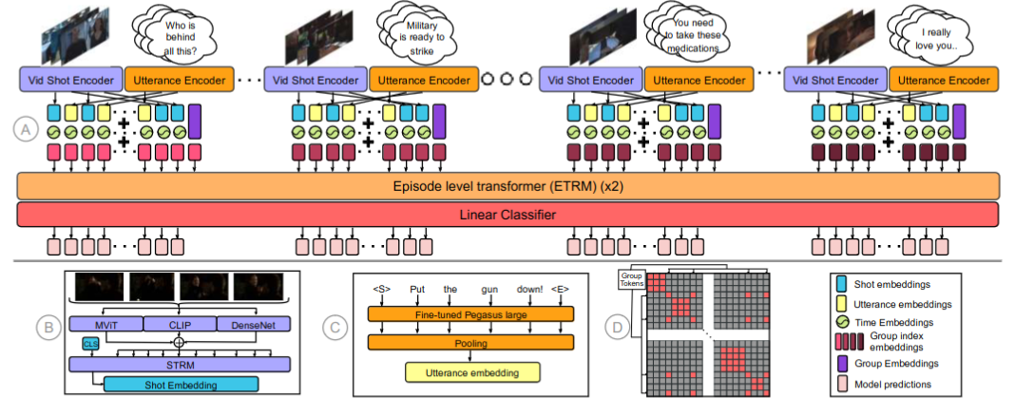

What do we mean by experiment tracking.
Projects grow and get complex over time.

Slide 13
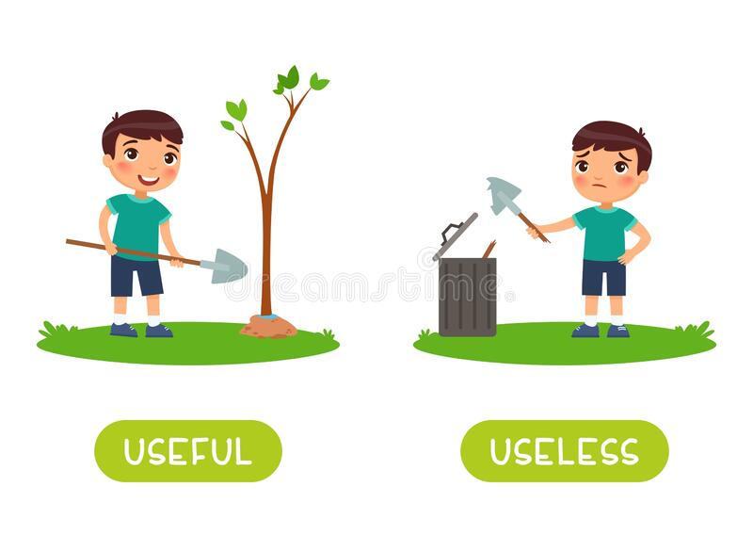
What do we mean by experiment tracking.
You may put a lot of efforts, those efforts should not be useless!

Slide 14
What do we mean by experiment tracking.
How experiment runs usually look like
There is no fun in analysing this!
{'epoch': 1, 'train_loss': 1.1452948740124702, 'eval_loss': 0.7713702845573426, 'train_ap_score': 0.6731415009678289, 'eval_ap_score': 0.8116030823185824, 'lr': 0.0001}
{'epoch': 2, 'train_loss': 0.5890168227255345, 'eval_loss': 0.6724603283405304, 'train_ap_score': 0.8755422621356335, 'eval_ap_score': 0.8489012873912365, 'lr': 0.0001}
{'epoch': 3, 'train_loss': 0.3640854485332966, 'eval_loss': 0.6902201867103577, 'train_ap_score': 0.9443318746126932, 'eval_ap_score': 0.8558312675174203, 'lr': 0.0001}
{'epoch': 4, 'train_loss': 0.20835940316319465, 'eval_loss': 0.733428498506546, 'train_ap_score': 0.9796843642719427, 'eval_ap_score': 0.8559268354265821, 'lr': 0.0001}
{'epoch': 5, 'train_loss': 0.1133101735264063, 'eval_loss': 0.8106619369983673, 'train_ap_score': 0.9937608794513503, 'eval_ap_score': 0.8549025780413813, 'lr': 0.0001}
{'epoch': 6, 'train_loss': 0.06395852622576058, 'eval_loss': 0.872140085697174, 'train_ap_score': 0.9981744515435429, 'eval_ap_score': 0.856293925063724, 'lr': 0.0001}

Slide 15
What do we mean by experiment tracking.
Improve your machine learning workflow
Without visualization/tracking, it is tough to answer queries like-
How long does it take to run your experiments?
Around what epoch does it start to overfit?
When scheduler updated the learning rate, how much did that affect the metrics? Did it even trigger?!
How to compare X different runs that only have change in one parameter? Which one to choose?
Many more…..

Slide 16

What do we mean by experiment tracking.
Research work needs support
Lab mates
Some friend
That friend
You

Slide 17

What do we mean by experiment tracking.
We will share one more friend with you today!
WandB
You

Slide 18
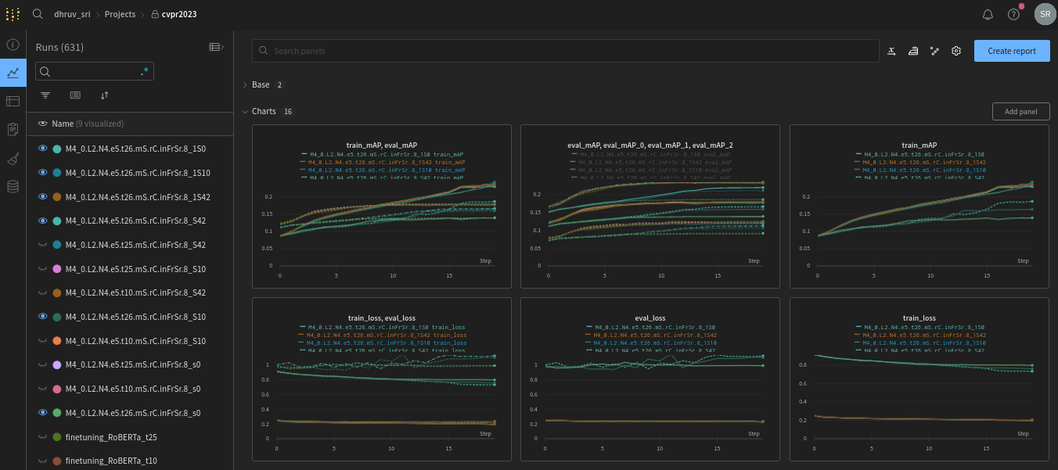
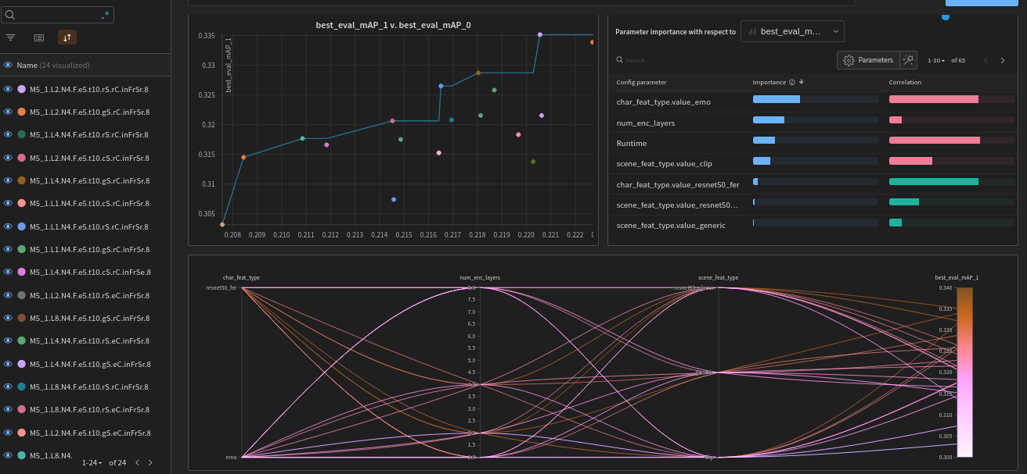
Introduction to WandB
One place for all you experiments
WandB is a powerful experiment tracking tool that helps machine learning practitioners to keep track of their models, datasets, and experiments. WandB offers a range of features including real-time visualization, hyperparameter tuning, and experiment comparison.
Code → github | Exp. → WandB
Easy to configure and use!

Slide 19
Lets jump to code
Log some configs and experiment data to WandB.

Slide 20
Head over to https://tinyurl.com/KathaAiWandB
https://wandb.ai/dhruv_sri/wandb_demo/

Slide 21
WandB sweeps
Overview
Wandb Website (server) (Generating unique configs based on definition)
GnodeX
(Running your code)
GnodeY (Running your code)
LabPC (Running your code)
Someone’s PC (Running your code)

Slide 22
Break

Slide 23
Visualization is worth a thousand words 😇: UI/UX of WandB

Slide 24
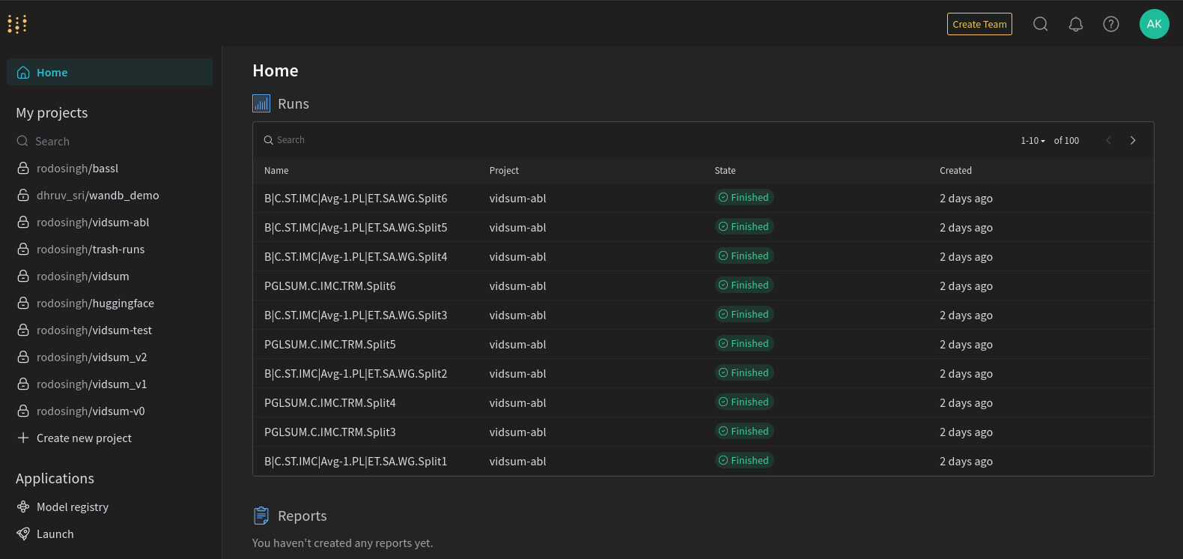
WandB Functionality
UI elements from COARSE to FINE and how to effectively use them
WandB Home - the GLOBAL view of all your experiments…

Slide 25
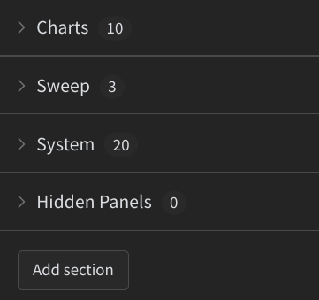
WandB Functionality
UI elements from COARSE to FINE
Sections
Charts
Sweep (If sweeping is done)
System
Hidden Panels
Miscellaneous (Smoothing, Outlier-handling, Layout Thingy)

Slide 26
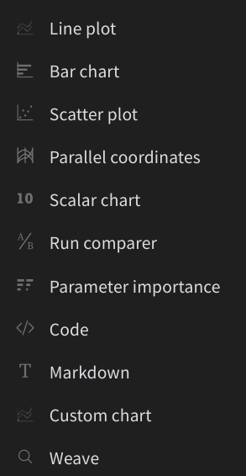
WandB Functionality
UI elements from COARSE to FINE
Adding a custom panel:
Line/Bar/Scatter/Parallel Plots
Run Comparer
Parameter Importance
Code
Markdown
Custom chart
Weave (to check/verify project essentials)

Slide 27
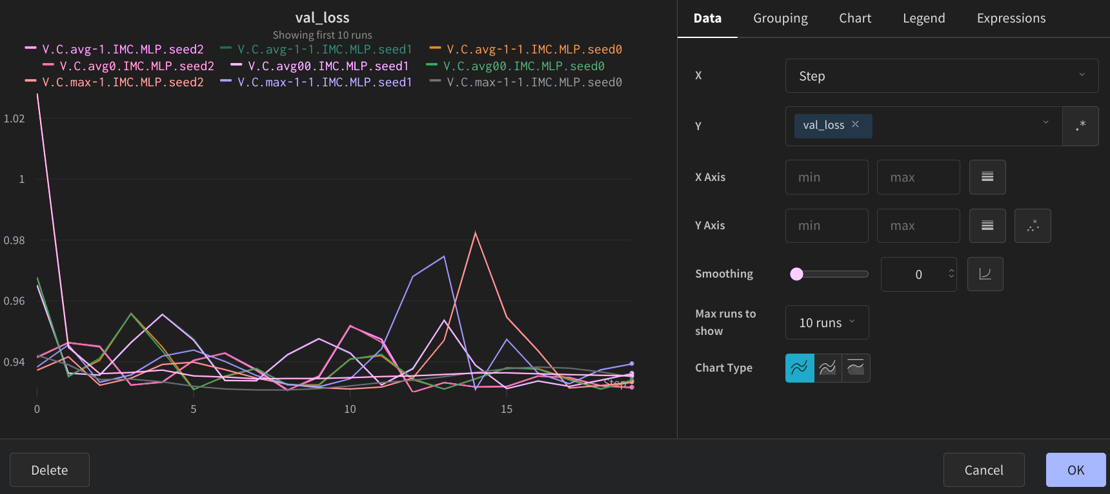
WandB RUNs - Chart View
Edit panel (Data, Grouping,
Chart, Legend, Expression)
Miscellaneous (Export, Duplicate, Download)

Slide 28
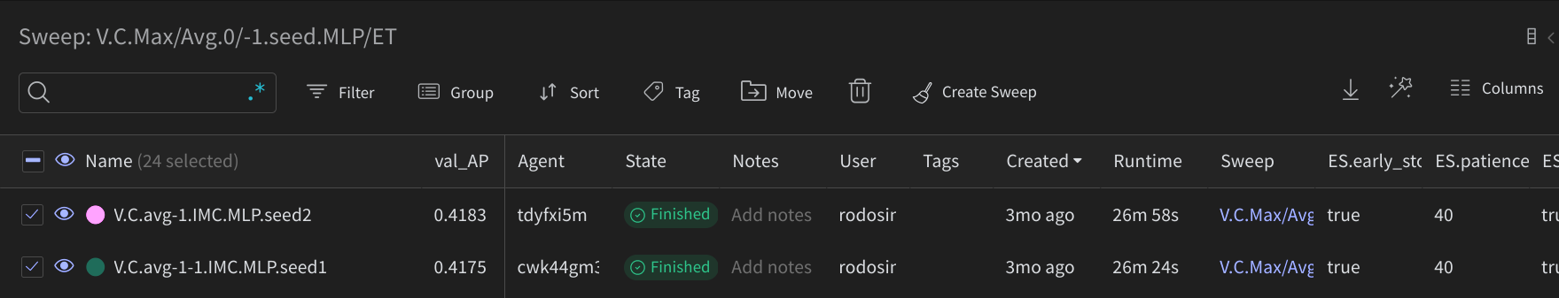
WandB RUNs - Table View
Search / Filter / Group
Sort
Tag
Move / Delete
Magic wand (feature selection)
Columns

Slide 29
Application of Sweeps
Generating configs automatically
Efficient ablation management
Grid Search
Visualizing and Comparing multiple runs (of our choice) through parallel coordinates plot.
We can engage as many gnodes (agents/workers) we want just by mentioning sweep-id.

Slide 30
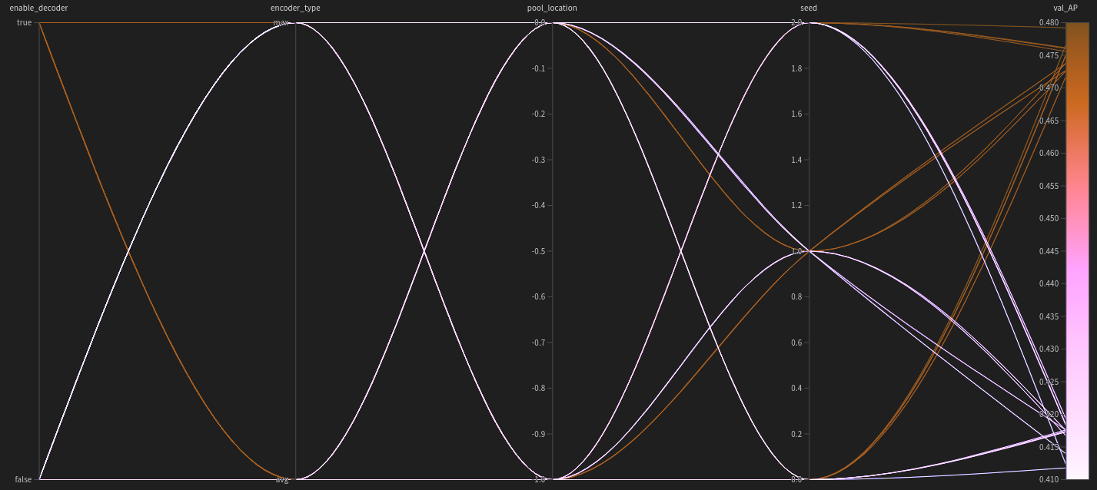
WandB Parallel Plots - A step towards HyperOpt
Parallel plots - OUR SAVIOR

Slide 31
Application of Sweeps (Revisited)
Efficient ablation management: Hassle free auto execution of every combination of varying parameters.
Grid Search: Can estimate feature importance (can be selected manually) based on metric objective.
Visualizing and Comparing multiple runs (of our choice) through parallel coordinates plot.
We can engage as many gnodes (agents/workers) we want just by mentioning sweep-id while submitting batch job for each gnode. This parallely completes all the runs expected in that sweep. No need to submit usual batch job (with all pre-requirements of data and code satisfied for that gnode).
So it does have a lot of perks, Agree? 🙇🙎🙆

Slide 32
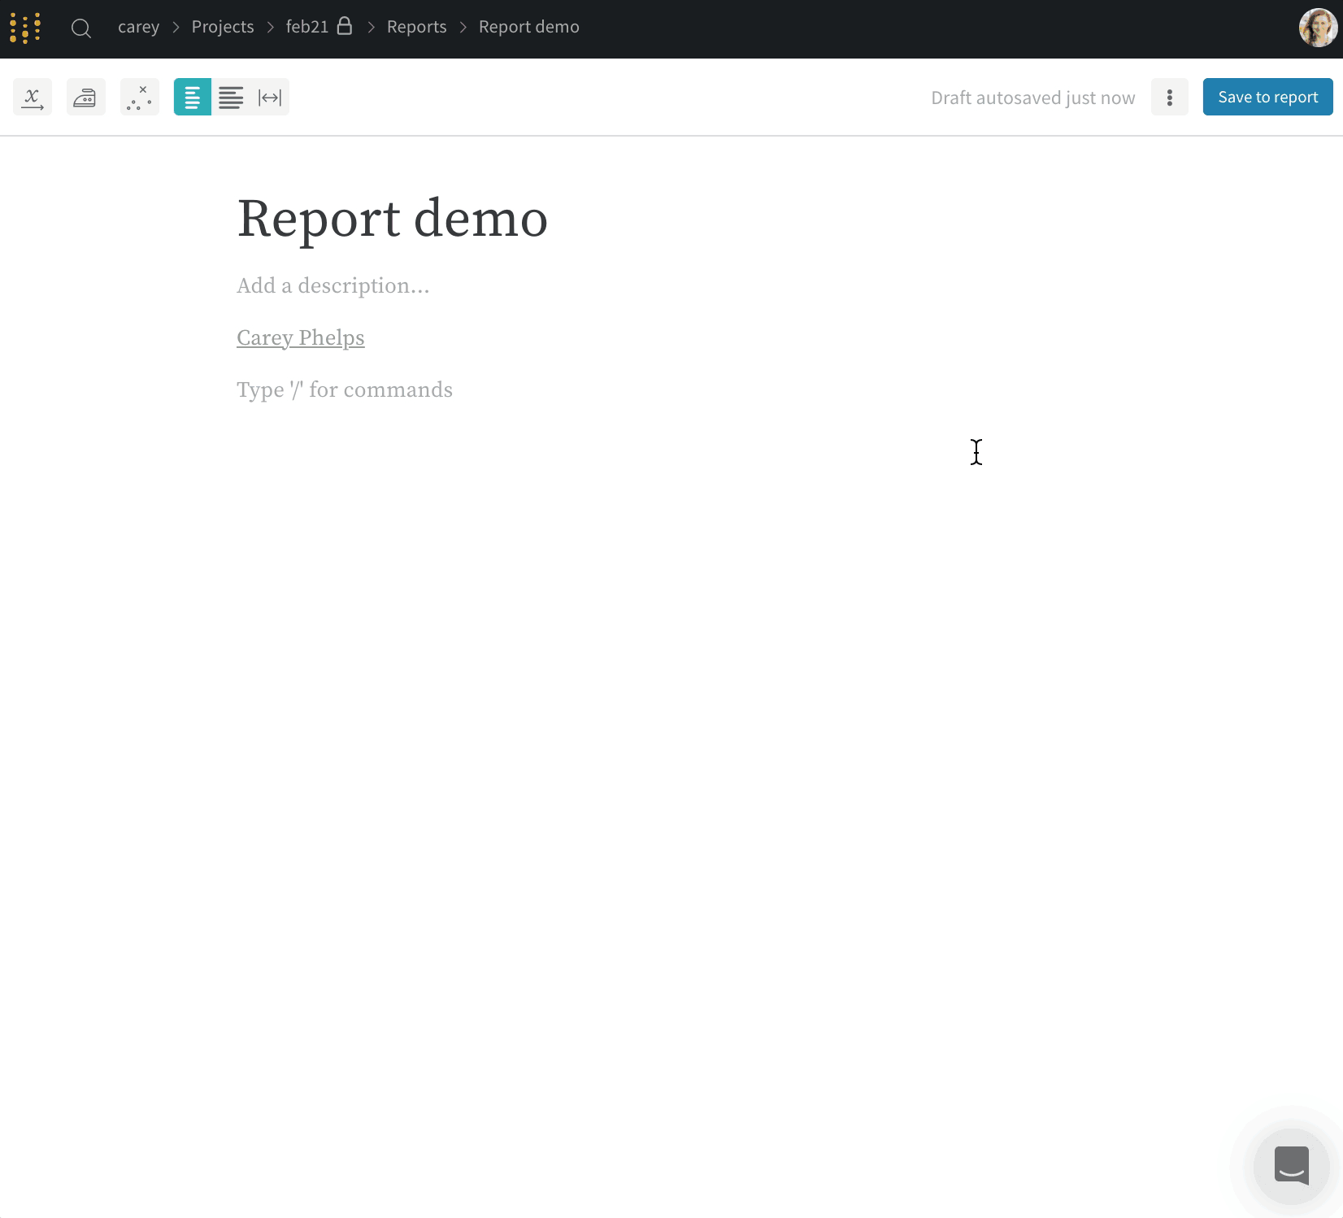
WandB Reports - [Better way to share your findings]
References:
Link1
Link2
Link3

Slide 33
ACHIEVE - 6 Perks of WandB
Experiment Reproducibility
Advanced Features
WandB
You
Integration and Compatibility
Visualization and Analysis
Collaboration and Sharing
Hyperparameter Optimization

Slide 34
Research Experiences
Good Research practices
Find the problem not the solution.
Thorough literature review
Designing experiments
Analysing the outcomes
Writing a paper
Submitting to a conference
Releasing the code and dataset
Publicize your work on social media!

Slide 35



Multiprocessing
Single Processing :( Concurrency Multiprocessing

Slide 36
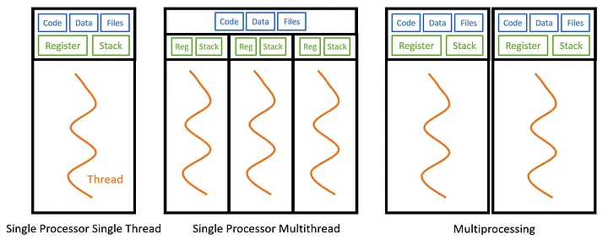
Multithreading vs Multiprocessing
Image Credits: Silberschatz et al., "Operating System Concepts", Chapter 4

Slide 37
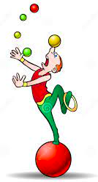
Multimodality
Credits: https://www.dreamstime.com/royalty-free-stock-photos-juggling-color-balls-acrobat-performer-image17323338

Slide 38
What are Vision Language models (VLMs)?
VLMs are a type of neural network models that combines computer vision and natural language processing techniques to perform a variety of different multimodal tasks such as image captioning, visual question answering, and image retrieval.
VLMs (like CLIP, Flamingo, BLIP, etc.) have been highly successful in recent years, with state-of-the-art results on various benchmark datasets for the above mentioned tasks.

Slide 39
What tasks can VLMs perform?
Image Captioning
Visual Question Answering (VQA)
Visual Grounding
Image-Text Matching
Text to Image Retrieval
Visual Scene Understanding

Slide 40
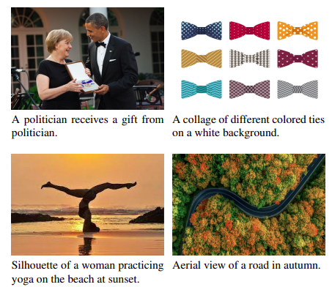
Image Captioning
Image Credits: https://arxiv.org/abs/2111.09734 (ClipCap)

Slide 41
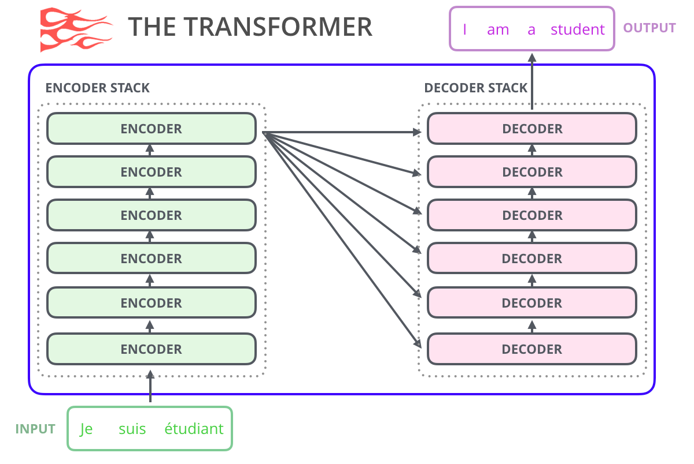
Transformer
Image Credits: https://jalammar.github.io/illustrated-gpt2/

Slide 42
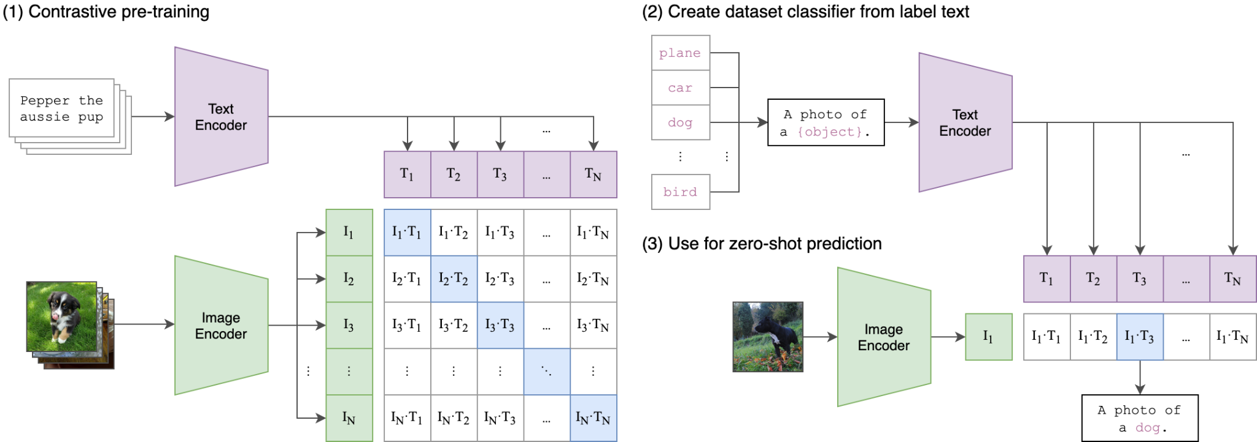
CLIP (Contrastive Language–Image Pre-training)
Image Credits: https://github.com/openai/CLIP

Slide 43

GPT: The Linguistic Genie
Credits: https://www.disneyclips.com/images/images/genie-lamp2.png

Slide 44
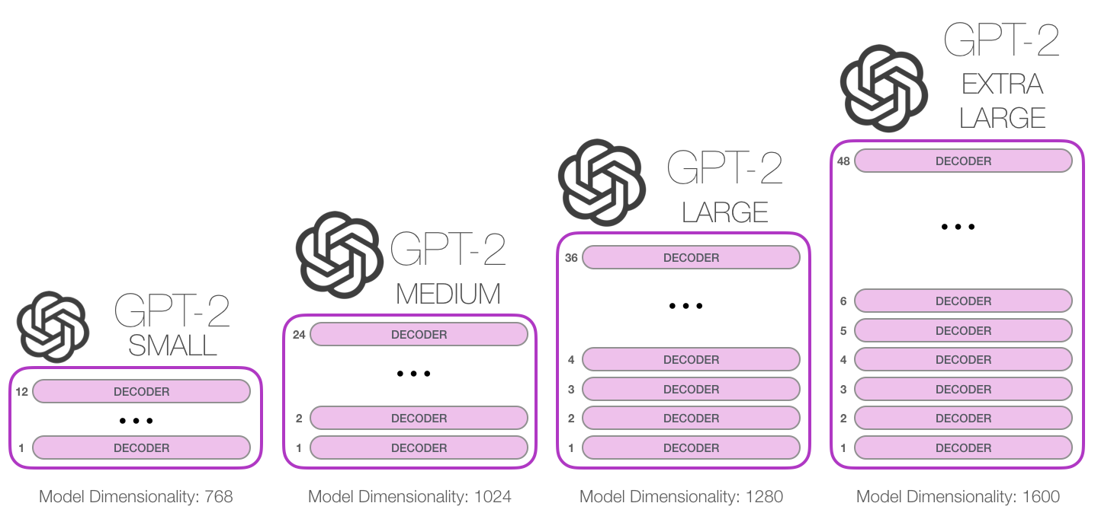
GPT-2
Image Credits: https://jalammar.github.io/illustrated-gpt2/

Slide 45
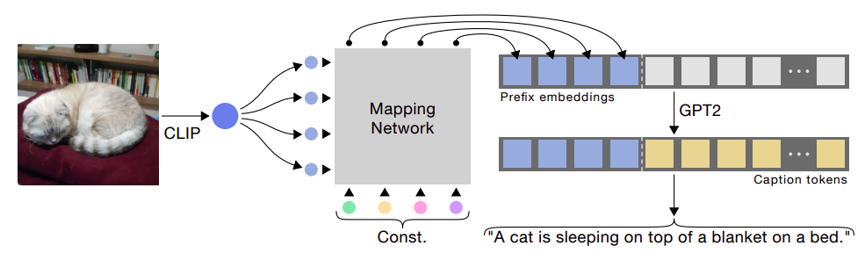
ClipCap: CLIP Prefix for Image Captioning¹
[1] https://arxiv.org/abs/2111.09734

Slide 46
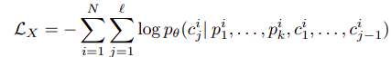
ClipCap: Objective Function¹
Dataset: images and captions
[1] https://arxiv.org/abs/2111.09734

Slide 47
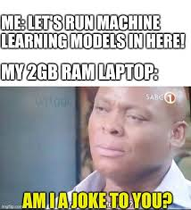
How and where to train the models?
Credits: https://xprilion.com/ml-on-2gb-ram/

Slide 48
ClipCap¹
Colab Notebook: tinyurl.com/mu8u4z9y (https://colab.research.google.com/drive/1ligZ0ZUABgcFWHKPmTgK6Sa_SVXB7hu3?usp=sharing)
[1] https://arxiv.org/abs/2111.09734

Slide 49
Thank You

